Slide 1
Health Benefit Review
MPELRA – March 26, 2021

Slide 2
Key Objectives
COVID update
Benefits market update
Medical/Rx market update
Current and emerging benefit cost control strategies
Please use the chat box to ask questions and raise points as we go!

Slide 3
Brief COVID Update

Slide 4
Change in Number of Health Care Claims, 2019-2020
Employee Benefits in a COVID-19 World – Six Month Update, IFEBP, January 2021

Slide 5
BCBSM 2020 Medical Trends

Slide 6
BCBSM Progression of Surgical Costs - 2020

Slide 7
BCBSM Future Cost Factors for Consideration

Slide 8
Benefits Market Update

Slide 9
What Are Some Benefit Trends in the Public Sector?

Slide 10
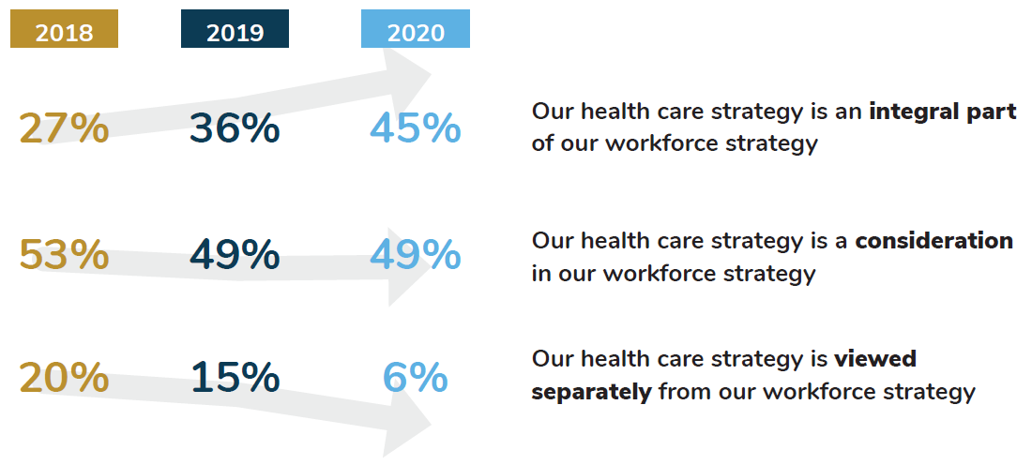
The Role of Healthcare in Large Employers’ Workforce Strategy, 2018-2020
Business Group on Health. 2021 Large Employers’ Health Care Strategy and Plan Design Survey. August 2020. Available at: https://www.businessgrouphealth.org/resources/2021-large-employers-health-care-strategy-and-plan-design-survey

Slide 11
Employee Experience
Source: Gallagher 2021 State of the Sector: Global Survey of Internal Communication and Employee Engagement (February 2021)

Slide 12
Medical/Rx Market Update

Slide 13
What’s New
Efforts to Control Healthcare Costs Continue
In 2019 US Healthcare spending $3.8 trillion
Hospital Care Up 6.2%
Physician Care Up 4.6%
Pharmacy Up 5.7%
Source – CMS.gov
Approximate BCBSM Trend numbers for January 1, 2021 renewals:
Hospital – 3.5%
Physician care – 3.4%
Pharmacy – 7.7%
Approximate BCBSM Trend numbers for July 1, 2021 renewals:
Hospital – 8.6%
Physician care – 8.5%
Pharmacy – 7.7%

Slide 14
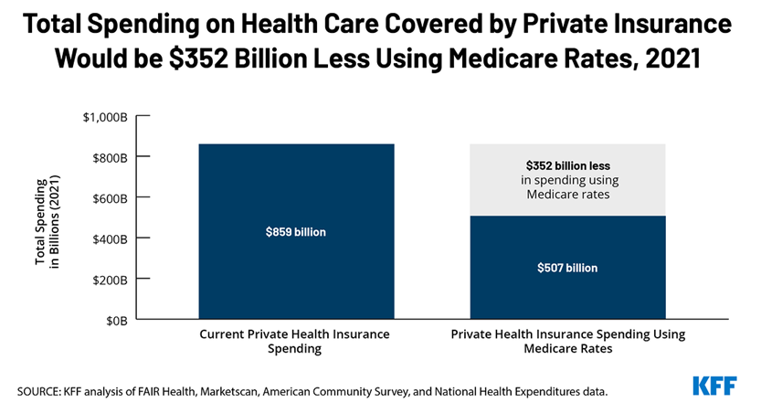
A Recent Article
45% of savings would come from outpatient hospital services
About a third of savings would come from lower healthcare spending on 55-64 year olds

Slide 15
Pharmacy Plan Management
This deserves a closer look
Complex
Opaque
Costly
Critical

Slide 16
The Players
Three players control the majority of the US PBM Market

Slide 17
Health Plan Partnerships
Coming soon…..
Medical Carrier | PBM Partner
BCBS Michigan | OptumRx, a UnitedHealth Group Company
Why the change to OptumRx?
Health plans, like employers, competitively market services, such as PBM partner.
Contractual Terms
Rebates
Flexibility
Discounts
Innovation
Fees
What is important in choosing a PBM?

Slide 18
Current and Emerging Cost Control Strategies

Slide 19
What Can I Do to Prepare?
Insured Group
Stay informed on carrier offerings
Pick the right carrier partner
Self-funded Group
Stay informed on carrier/TPA/PBM offerings
Build effective communications
Build effective communications
Weigh your options to go direct to vendors that could benefit your population

Slide 20
Chronic Conditions
Chronic Illnesses Account for 75% of Healthcare Spending Each Year
Economic impact of the 7 most common chronic conditions is $1.3 trillion, going to $6 trillion by 2050 on current trajectory
Source – Partnership to Fight Chronic Disease

Slide 21
Vendor Point Solutions
Pre-diabetes/diabetes
Hypertension
Musculoskeletal (MSK)
Behavioral health

Slide 22
Exclusive Access for Specialty Medications
Members must access specialty medications through a dedicated, mail-order specialty pharmacy or at select retail pharmacies
Increased discounts on high cost drugs
Lower overall specialty drug spend
Avoidance of future risk exposure

Slide 23
Cooperative Purchasing
Leverage collective size to drive enhanced pharmacy benefit manager contract terms
Deeper discounts
Higher rebates
Performance and service guarantees
Gain transparency into program performance
Access additional funds to support initiatives associated with the pharmacy benefit

Slide 24
Direct Purchase of Prescription Drugs
International
Canada
Mexico
Cayman Islands
New Zealand
Key Considerations:
Legality
Compliance
Voluntary Participation
Stoploss
PBM Integration
Safety
Disruption
Importing prescription drugs from other countries
Obtaining prescription drugs directly from the manufacturer
Pharmacy “tourism”

Slide 25
Case Study
Pooling Health Insurance Risk
Background
Michigan public sector employer with staff enrolled with BCBSM/BCN
Organization leadership understood and appreciated philosophy of pooling risk
Challenge
Seeking more strategic and stable health insurance program
Solution
The group joined WMHIP (aka “the Pool”) to which Gallagher consults; in existence since 2005 with a strong track record of stable performance (The Pool’s average annual increase over the past five years is 4.6%)
Results
Smooth transition to the Pool
Joined with over 110 other Michigan public sector groups and over 12,000 employee lives
Gained transparent access to claims and fees
Became part of a shared risk model which keeps claims and premium fluctuation down
Able to provide employees with access to value-added third party vendors such as 2nd MD
Factors to consider
Is the concept of pooling consistent with your organization’s philosophy on benefit program strategy?
Is there interest on the part of both the union and administration to understand market alternatives?
If answer to both items above is “yes”, begin conversations well in advance of your healthcare renewal

Slide 26
Questions? Please contact:
Chadd Hodkinson
Area Vice President
517-898-7752
Chadd_Hodkinson@ajg.com
Consulting and insurance brokerage services to be provided by Gallagher Benefit Services, Inc. and/or its affiliate Gallagher Benefit Services (Canada) Group Inc. Gallagher Benefit Services, Inc., a non-investment firm and subsidiary of Arthur J. Gallagher & Co., is a licensed insurance agency that does business in California as “Gallagher Benefit Services of California Insurance Services” and in Massachusetts as “Gallagher Benefit Insurance Services.” Investment advisory services and corresponding named fiduciary services may be offered through Gallagher Fiduciary Advisors, LLC, a Registered Investment Adviser. Gallagher Fiduciary Advisors, LLC is a single-member, limited-liability company, with Gallagher Benefit Services, Inc. as its single member. Certain appropriately licensed individuals of Arthur J. Gallagher & Co. subsidiaries or affiliates, excluding Gallagher Fiduciary Advisors, LLC, offer securities through Kestra Investment Services (Kestra IS), member FINRA/SIPC and or investment advisory services through Kestra Advisory Services (Kestra AS), an affiliate of Kestra IS. Neither Kestra IS nor Kestra AS is affiliated with Arthur J. Gallagher & Co., Gallagher Benefit Services, Inc. or Gallagher Fiduciary Advisors, LLC. Neither Kestra AS, Kestra IS, Arthur J. Gallagher & Co., nor their affiliates provide accounting, legal, or tax advice.

